Slide 1
Chapter 15 – Cluster Analysis
Data Mining for Business Analytics (3rd ed.)
Shmueli, Bruce & Patel

Slide 2
Clustering: The Main Idea
Goal: Form groups (clusters) of similar records
Used for segmenting markets into groups of similar customers
Example: Claritas segmented US neighborhoods based on demographics & income: “Furs & station wagons,” “Money & Brains”, …

Slide 3
Other Applications
Periodic table of the elements
Classification of species
Grouping securities in portfolios
Grouping firms for structural analysis of economy
Army uniform sizes

Slide 4
Example: Public Utilities
Goal: find clusters of similar utilities
Data: 22 firms, 8 variables
Fixed-charge covering ratio
Rate of return on capital
Cost per kilowatt capacity
Annual load factor
Growth in peak demand
Sales
% nuclear
Fuel costs per kwh

Slide 5
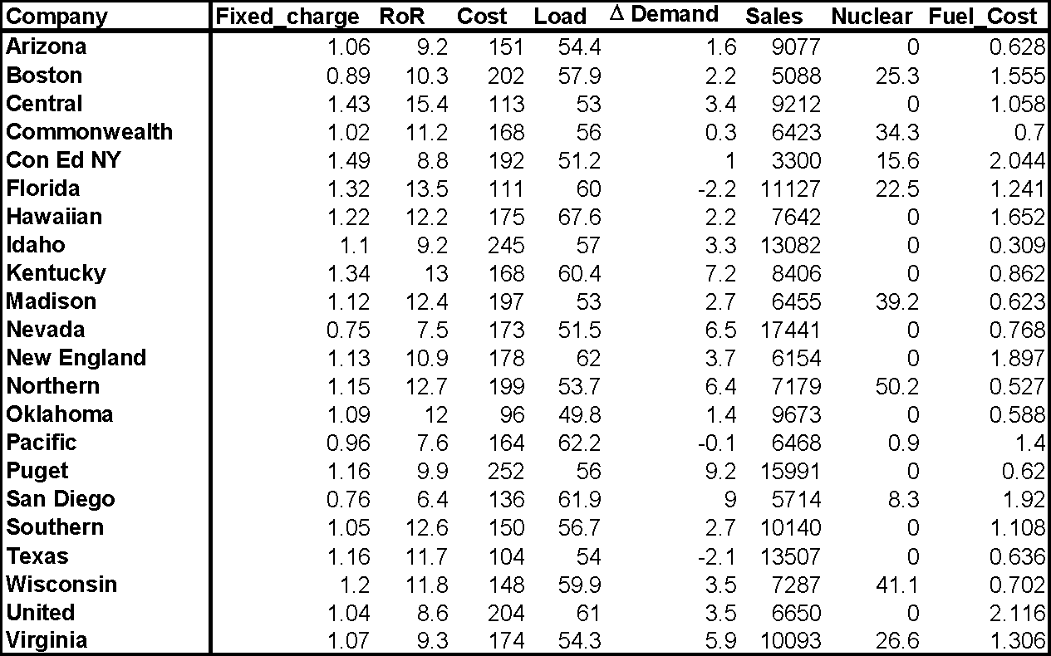

Slide 6
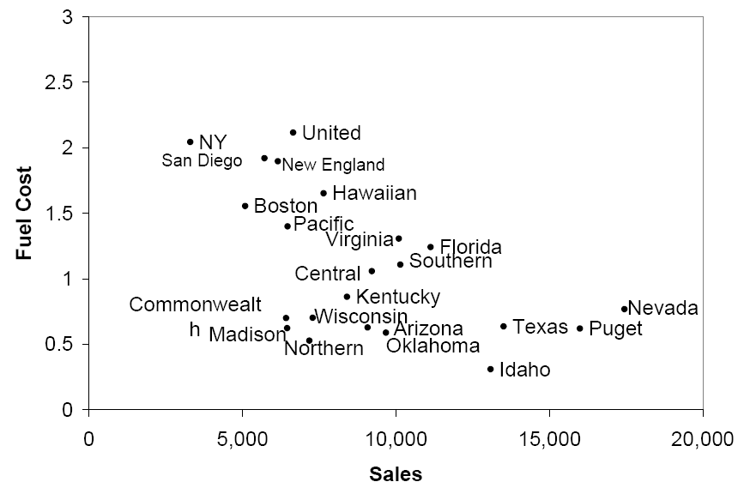
Sales & Fuel Cost:
3 rough clusters can be seen
High fuel cost, low sales
Low fuel cost, high sales
Low fuel cost, low sales

Slide 7
Extension to More Than 2 Dimensions
In prior example, clustering was done by eye
Multiple dimensions require formal algorithm with
A distance measure
A way to use the distance measure in forming clusters
We will consider two algorithms: hierarchical and non-hierarchical

Slide 8
Hierarchical Clustering

Slide 9
Hierarchical Methods
Agglomerative Methods
Begin with n-clusters (each record its own cluster)
Keep joining records into clusters until one cluster is left (the entire data set)
Most popular
Divisive Methods
Start with one all-inclusive cluster
Repeatedly divide into smaller clusters

Slide 10
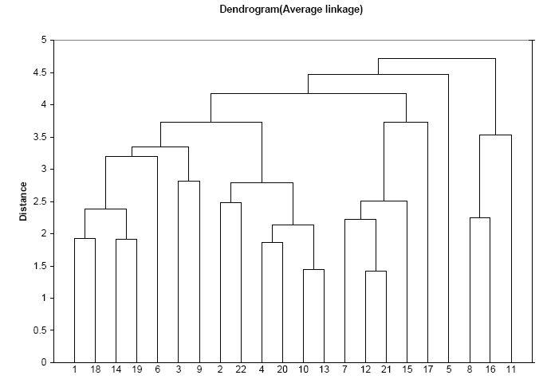
A Dendrogram shows the cluster hierarchy

Slide 11
Measuring Distance
Between records
Between clusters

Slide 12
Measuring Distance Between Records
Notes:
‹#›

Slide 13
Distance Between Two Records
Euclidean Distance is most popular:
Notes:
‹#›

Slide 14
Normalizing
Problem: Raw distance measures are highly influenced by scale of measurements
Solution: normalize (standardize) the data first
Subtract mean, divide by std. deviation
Also called z-scores

Slide 15
Example: Normalization
For 22 utilities:
Avg. sales = 8,914
Std. dev. = 3,550
Normalized score for Arizona sales:
(9,077-8,914)/3,550 = 0.046

Slide 16
Compute Distance Matrix for Utility Pairs
utilities.df <- read.csv("Utilities.csv")
# set row names to the utilities column
row.names(utilities.df) <- utilities.df[,1]
# remove the utility column
utilities.df <- utilities.df[,-1]
# compute Euclidean distance
d <- dist(utilities.df, method = "euclidean")
Could use a variety of metrics here, see R documentation for dist

Slide 17

Output of Distance Matrix (showing first 5 pairs)

Slide 18
Code for Normalizing then Computing Distance
scale, without further arguments, normalizes each column
# normalize input variables
utilities.df.norm <- sapply(utilities.df, scale)
# add row names: utilities
row.names(utilities.df.norm) <- row.names(utilities.df)
# compute normalized distance based on Sales (column
6) and Fuel Cost (column 8)
d.norm <- dist(utilities.df.norm[,c(6,8)], method =
"euclidean")

Slide 19
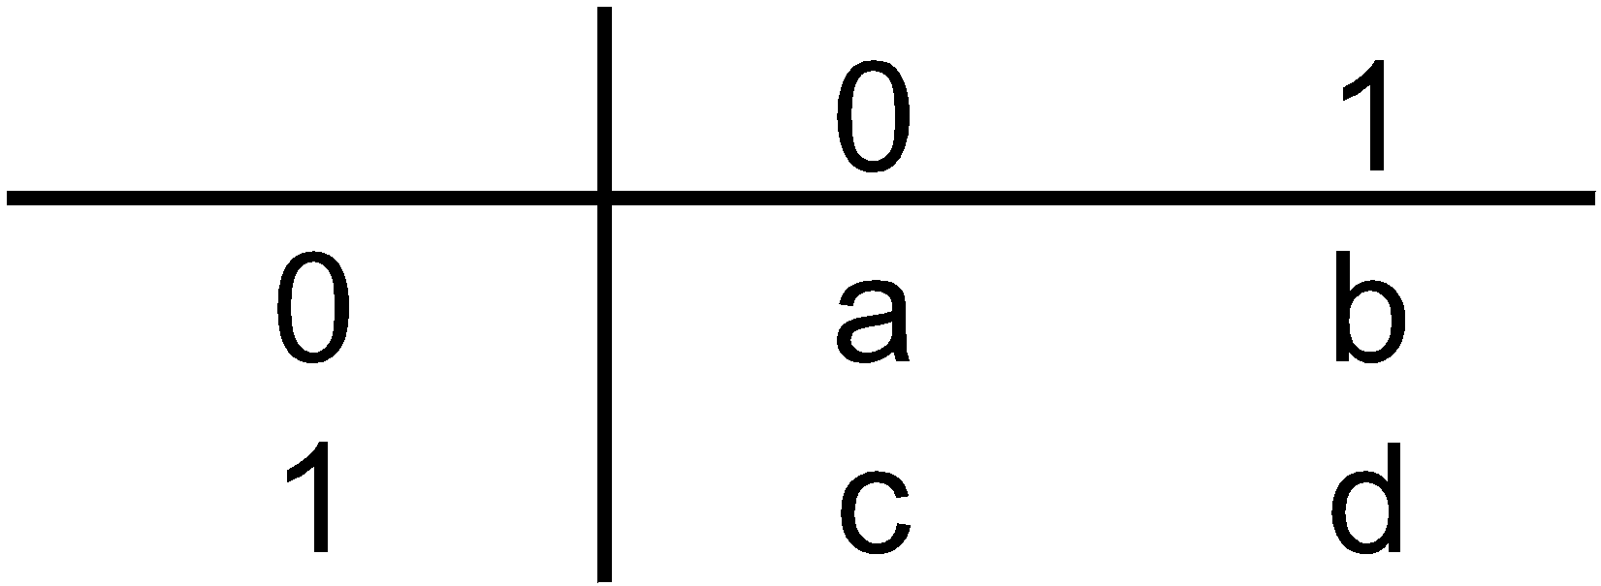
For Categorical Data: Similarity
To measure the distance between records in terms of two 0/1 variables, create table with counts:
Similarity metrics based on this table:
Matching coef. = (a+d)/p
Jaquard’s coef. = d/(b+c+d)
Use in cases where a matching “1” is much greater evidence of similarity than matching “0” (e.g. “owns Corvette”)

Slide 20
Other Distance Measures
Correlation-based similarity
Statistical distance (Mahalanobis)
Manhattan distance (absolute differences)
Maximum coordinate distance
Gower’s similarity (for mixed variable types: continuous & categorical)

Slide 21
Measuring Distance Between Clusters

Slide 22
Minimum Distance (Cluster A to Cluster B)
Also called single linkage
Distance between two clusters is the distance between the pair of records A_{i} and B_{j} that are closest

Slide 23
Maximum Distance (Cluster A to Cluster B)
Also called complete linkage
Distance between two clusters is the distance between the pair of records A_{i} and B_{j} that are farthest from each other

Slide 24
Average Distance
Also called average linkage
Distance between two clusters is the average of all possible pair-wise distances

Slide 25
Centroid Distance
Distance between two clusters is the distance between the two cluster centroids.
Centroid is the vector of variable averages for all records in a cluster

Slide 26
The Hierarchical Clustering Steps (Using Agglomerative Method)
Start with n clusters (each record is its own cluster)
Merge two closest records into one cluster
At each successive step, the two clusters closest to each other are merged
Dendrogram, from bottom up, illustrates the process

Slide 27
Code for Hierarchical Clustering and Plotting the Dendrogram
# in hclust() set argument method =
# to "ward.D", "single", "complete", "average",
"median", or "centroid“
hc1 <- hclust(d.norm, method = "single")
plot(hc1, hang = -1, ann = FALSE)
turns off annotation (plot and axis titles)
causes x-axis labels to hang below the 0 line

Slide 28
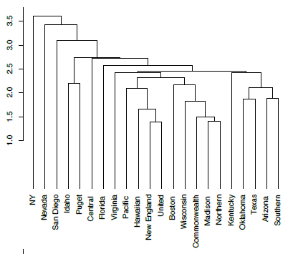
Dendrogram for Single Linkage
two closest records form first cluster

Slide 29
Reading the Dendrogram
See process of clustering: Lines connected lower down are merged earlier
New England and United will be merged first, then Madison and Northern
Determining number of clusters: For a given “distance between clusters”, a horizontal line intersects the clusters that are that far apart, to create clusters
E.g., at distance of 3.5 (red line in next slide), data can be reduced to 2 clusters – NY (singleton cluster) and all others
At distance of 2.6 (green line in following slide) data can be reduced to 6 clusters – 4 singletons, 1 doubleton, and all others

Slide 30
Dendrogram for Single Linkage
If clusters must be at least 3.5 units apart, then you have 2 clusters – NY (singleton) and all others
two closest records form first cluster

Slide 31
Dendrogram for Single Linkage
At 2.6 units of distance, there are 6 clusters
two closest records form first cluster

Slide 32
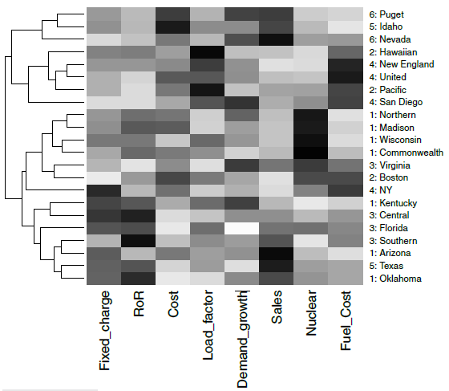
Visualize Cluster Features with Heatmap
(darker = higher values)
Considering 3 clusters, bottom cluster has higher Fixed_charge and RoR than the other two

Slide 33
Validating Clusters

Slide 34
Interpretation
Goal: obtain meaningful and useful clusters
Caveats:
(1) Random chance can often produce apparent clusters
(2) Different cluster methods produce different results
Solutions:
Obtain summary statistics
Also review clusters in terms of variables not used in clustering
Label the cluster (e.g. clustering of financial firms in 2008 might yield label like “midsize, sub-prime loser”)

Slide 35
Desirable Cluster Features
Stability – are clusters and cluster assignments sensitive to slight changes in inputs? Are cluster assignments in partition B similar to partition A?
Separation – check ratio of between-cluster variation to within-cluster variation (higher is better)

Slide 36
Nonhierarchical Clustering: K-Means Clustering

Slide 37
K-Means Clustering Algorithm
Choose # of clusters desired, k
Start with a partition into k clusters
Often based on random selection of k centroids
At each step, move each record to cluster with closest centroid
Recompute centroids, repeat step 3
Stop when moving records increases within-cluster dispersion

Slide 38
K-means Algorithm: Choosing k and Initial Partitioning
Choose k based on the how results will be used
e.g., “How many market segments do we want?”
Also experiment with slightly different k’s
Initial partition into clusters can be random, or based on domain knowledge
If random partition, repeat the process with different random partitions

Slide 39
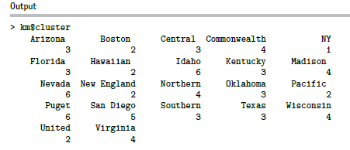
Code for K-means Clustering
(data prep as for hierarchical)
ask for 6 clusters
km <- kmeans(utilities.df.norm, 6)
# show cluster membership
km$cluster

Slide 40
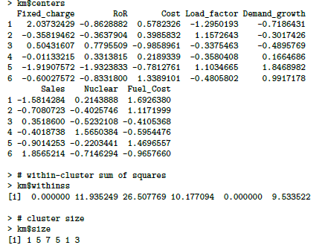
Cluster Characteristics
Centroids = each cluster has a vector of variable means
Custer 1 has normalized average demand growth of -0.7186
Clusters 1 and 5 are each singletons, so within-cluster distance = 0
number of utilities in each cluster

Slide 41
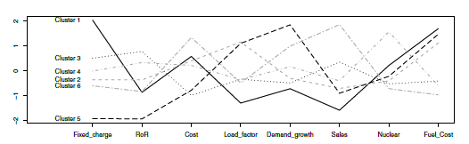
Visualize Cluster Centroids with Profile Plot
# plot an empty scatter plot
plot(c(0), xaxt = 'n', ylab = "", type = "l", ylim =
c(min(km$centers), max(km$centers)), xlim = c(0, 8))
# label x-axes
axis(1, at = c(1:8), labels = names(utilities.df))
# plot centroids
for (i in c(1:6))
lines(km$centers[i,], lty = i, lwd = 2, col = ifelse(i %in% c(1, 3, 5),"black", "dark grey"))
# name clusters
text(x = 0.5, y = km$centers[, 1], labels = paste("Cluster“, c(1:6)))

Slide 42
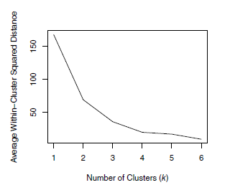
Different Choices for K
As the number of clusters increases, the cluster members are closer to one another.
Question: What happens to the distance between clusters?

Slide 43
Summary
Cluster analysis is an exploratory tool. Useful only when it produces meaningful clusters
Hierarchical clustering gives visual representation of different levels of clustering
On other hand, due to non-iterative nature, it can be unstable, can vary highly depending on settings, and is computationally expensive
Non-hierarchical is computationally cheap and more stable; requires user to set k
Can use both methods
Be wary of chance results; data may not have definitive “real” clusters

